Slide 1
COMP 249:
Object Oriented Programming II
Chapter 7 - Inheritance

Slide 2

Class SavingsAccount
public class SavingsAccount
{
private int acctNum;
private int balance;
private String name;
private double interestRate;
public SavingsAccount() {
acctNum = 0;
balance = 0;
name = "";
interestRate = 0;
}
public double getBalance()
{ … }
public void deposit(double amount)
{ … }
…
}

Slide 3

Class CheckingAccount
public class CheckingAccount
{
private int acctNum;
private int balance;
private String name;
private int maxNumCheques;
public CheckingAccount() {
acctNum = 0;
balance = 0;
name = "";
maxNumCheques = 0;
}
public double getBalance ()
{ … }
public void deposit (double amount)
{ … }
…
}

Slide 4
Comparing Accounts ….
public class SavingsAccount {
private int acctNum;
private int balance;
private String name;
private double interestRate;
public SavingsAccount() {
acctNum = 0;
balance = 0;
name = "";
interestRate = 0;
}
public double getBalance()
{ … }
public void deposit(double amount)
{ … }
…
}
public class CheckingAccount {
private int acctNum;
private int balance;
private String name;
private int maxNumCheques;
public CheckingAccount() {
acctNum = 0;
balance = 0;
name = "";
maxNumCheques = 0;
}
public double getBalance()
{ … }
public void deposit(double amount)
{ … }
…
}

Slide 5

Solution …
BankAccount
int acctNum;
int balance;
String name;
double getBalance();
void deposit();
SavingsAccount
double interestRate;
double computeInterest();
…
ChequingAccount
int maxNumCheques;
…

Slide 6
Inheritance
P
C
When a class C acquires the properties of another
class P, then class C is said to have inherited class P
  class P is called base, parent or super class
  class C is called a child or sub class.
A subclass inherits the members defined by the super class and adds its own, unique elements.
The keyword extends is used to inherit a class.
Ex: class subclass extends superclass {…}

Slide 7
Class BankAccount
BankAccount
int acctNum;
int balance;
String name;
double getBalance();
void deposit();
public class BankAccount {
int acctNum;
int balance
String name;
public BankAccount() {
acctNum = 0;
balance = 0;
name = "";
}
public double getBalance () { … }
public void deposit (double money) { … }
…
}

Slide 8

New SavingsAccount Class
public class SavingsAccount ___________ ___________
{
private double interestRate; // specific to savings accounts
public SavingsAccount() {
interestRate = 0;
}
// specific methods of a savings account
public double computeInterest() {…}
}
SavingsAccount
double interestRate;
double computeInterest();
…

Slide 9
New ChequingAccount Class:
public class __________ _________ ___________
{
____________________
public CheckingAccount(____________) {
___________________;
}
}
ChequingAccount
int maxNumCheques;
…

Slide 10
Inheritance
More sophisticated form of code re-use
Requires significant similarities between objects
Represents the IS-A relation
Examples:
  a (any) Monkey is-a Primate
  a (any) Dictionary is-a Book
Not to confuse with instances of classes
  Koko is a specific monkey
  Webster is a specific dictionary

Slide 11

Class Book
class Book {
private int pages = 1500;
public void setPages(int numPages) {
pages = numPages;
}
public int getPages() {
return pages;
}
}

Slide 12

Class Dictionary
class Dictionary extends Book {
private int definitions = 52500;
public void setDefinitions(int numDef) {
definitions = numDef;
}
public int getDefinitions() {
return definitions;
}
public double computeRatio() {
return
    definitions/pages;
    definitions/getPages();
    getDefinitions()/pages;
    getDefinitions()/getPages();
    Only 2 are valid
} //computeration
}

Slide 13
Example: Words.java
public class Words {
public static void main (String[] args) {
Dictionary webster = new Dictionary();
System.out.println("Nb of pages:" + webster.getPages());
System.out.println("Nb of defs:"+webster.getDefinitions());
System.out.println("Defs per page:"+webster.computeRatio());
}
}
Output
Book
int pages = 1500;
void setPages(int numPages);
int getPages();
Dictionary
int definitions = 52500;
void setDefinitions(int numDef);
int getDefinitions() …
double computeRatio() …

Slide 14
Inheritance vs Composition
inheritance is _________ relation
  ex: Bank.java, Sport.java
composition is ________ relation
  ex: Car.java

Slide 15

Sport.java
(is a ….)
Athlete
String name; String sport;
String getName(); String getSport();
void setName(); void setSport();
ProAthlete
String team; double salary;
String getTeam();
double getSalary();
void setName();
void setSalary();
AmateurAthlete
String province;
String getProvince();
void setProvince();
CompetitiveAthlete
String funding;
String getFunding();
void setFunding();
RecreationalAthlete
String getName();

Slide 16



Car.java (has a ….)
Engine
void start();
void stop();
void rev();
Door
void open();
void close();
Window
Void rollDown();
void rollUp();
Wheel
void inflate();
Car
Engine engine;
Door left;
Door right;
Wheel[] wheel;

Slide 17
Class Hierarchies
A child class can itself be the parent of another class, forming a class hierarchy
Good class design: put all common features as high in the hierarchy as is reasonable
An inherited member is continually passed down the line
Book
Person
Dictionary
Novel
Prof
Student
Mystery
Romance
Undergrad
Grad

Slide 18
Just Checking
What does a derived class automatically inherit from the base class?
    instance variables
    static variables
    public methods
    all of the above

Slide 19
Method Overriding (p. 433)
Typically, we add functionality to the derived class
Two ways:
  Write completely new methods
  Re-define inherited ones
Method overriding
  Derived class re-defines an inherited method
  Can we still access the parent method? _______

Slide 20
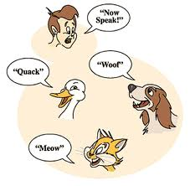
Method Overriding
The new method must have:
  the same signature and return type as the parent's method,
  but can have different code (obviously!)
The type of the object executing
the method determines which
version of the method is invoked
(the derived class or the parent's)

Slide 21
Example1: Method Overriding
public class Parent {
public void hello() {
System.out.println(“Hello from parent”);
}
}
public class Child extends Parent {
public void hello() {
System.out.println(“Hello from Child”);
}
}
…
Child baby = new Child();
baby.hello();
…
output?

Slide 22

Method Overriding
final methods cannot be overridden (by definition)
static methods cannot be overridden
variables can be overridden
  called shadowing variables
  but don't do it… it's confusing

Slide 23

Overriding vs overloading
Overriding and overloading are 2 different things!
Overriding =
  a child overrides its parent's method
  i.e. provides the same signature and return type, but different code
Overloading =
  not necessarily related to inheritance
  2 methods have the same name but
  different argument list

Slide 24
Example: Overload vs Override
class OverLoad {
public int xyz = 9;
public void stuff(int x){
System.out.println("x is an int in OverLoad");
}
public void stuff(double x){ // overloading? overriding?
System.out.println("x is a double in OverLoad");
}
}
class OverRide extends OverLoad {
public int xyz = 99; // don't do this! creates confusion
public void stuff (char x){ // overloading? overriding?
System.out.println("x is a char in overRide");
}
public void stuff (int x) { // overloading? overriding?
System.out.println("x is an int in overRide");
System.out.println("call parent stuff(int x)");
super.stuff(x);
}
}
see Over.java

Slide 25
So output is?
public static void main(String[] args) {
OverLoad testA = new OverLoad();
testA.stuff(4);
testA.stuff(4.0);
System.out.println("xyz in parent = " + testA.xyz);
System.out.println();
…
class OverLoad {
public int xyz = 9;
public void stuff(int x){
System.out.println("x is an int in OverLoad"); }
public void stuff(double x){
System.out.println("x is a double in OverLoad");} }

Slide 26
So output is …?
…
OverRide testB = new OverRide();
testB.stuff('4');
testB.stuff(4.0);
testB.stuff(4);
System.out.println("xyz in child = " + testB.xyz);
}
class OverRide extends OverLoad {
public int xyz = 99; // don't do this! creates confusion
public void stuff (char x){
System.out.println("x is a char in overRide");}
public void stuff (int x) {
System.out.println("x is an int in overRide");
System.out.println("call parent stuff(int x)");
super.stuff(x);}
}

Slide 27

The super constructor
A child class inherits its parent's members
Sometimes we need to access directly the parent's members (rather than inherited version)
The super keyword
  super. member --> always uses the superclass’s member
    ex: super.aMethod()
    ex: super.anAttribute
  super() --> calls the constructor of its immediate superclass (more details in 2 min.)
Can we do super.super.aMethod()?
Vehicule
Car
Boat

Slide 28
Example: super
public class BankAccount {
protected double getBalance() {return 1000.0;}
}
--------------------------------------------------
public class SavingsAccount extends BankAccount{
protected double getBalance() {return 1010.0;}
protected void printBalance() {
  System.out.println(super.getBalance());
  System.out.println(getBalance());
  System.out.println(this.getBalance());
  }
}
Output?

Slide 29
The this Constructor
In a constructor, this can be used as a name for invoking another constructor in the same class
  same restrictions on super apply to this
If you have to call super and this
  call this first,
  then the constructor that is called must call super as its first action
  can’t have both in a same methd

Slide 30
The this Constructor
Often, a no-argument constructor uses this to
invoke an explicit-value constructor
Example:
  public HourlyEmployee() {
  this("No name", new Date(), 0, 0);
  }
  public HourlyEmployee(String theName,
  Date theDate,
  double theWageRate,
  double theHours)
  {…}

Slide 31
Inheritance and Constructors
Constructors are not inherited, even though they have public visibility
But we often want to use the parent's constructor to initialize the "parent's part" of the object
Initialize from parent class down to current derived class

Slide 32
Inheritance and Constructors
If you don't call the parent's constructor yourself:
  Java will automatically call super() (parent's constructor) as 1st line of every constructor
So if you provide your own constructors with arguments
  You must explicitly call the parent's constructor (super(argument list)) since no default constructor will be provided

Slide 33
Inheritance and Constructors
public class BankAccount {
int acctNum; int balance;
String name;
public BankAccount(int aNum, int aBal;
String aName) {
acctNum = aNum; balance = aBal;
name = aName;}
public double getBalance () { … }
… }
public class SavingsAccount extends Account {
double interest;
public SavingsAccount(int aNum, int aBalString aName, double aRate) {
super(aNum, aBal,aName); //explicit call to parent's
// constructor
interest = aRate;
} }

Slide 34
What if you forget the call…
public class BankAccount {
int acctNum; int balance;
String name;
public BankAccount(int aNum, int aBal; String aName) {
acctNum = aNum;
balance = aBal;
name = aName;
}
public double getBalance () { … }
…
}
public class SavingsAccount extends Account {
double interest;
public SavingsAccount(int aNum, int aBalString aName, double aRate) {
//super(aNum, aBal,aName); //explicit call to parent's
// constructor
interest = aRate;
}
}

Slide 35
Simple Examples:
SuperCartoon.java
SuperWords.java

Slide 36
SuperCartoon.java
class SuperArt {
public SuperArt(int x) {
System.out.println("Art constructor");
}
}
class SuperDrawing extends SuperArt {
public SuperDrawing(int x) {
// the parent constructor has an argument so
// you must invoke the parent properly
super(x);
System.out.println("Drawing constructor");
}
}
SuperArt
SuperArt(int x):
SuperDrawing
SuperDrawing(int x);

Slide 37
SuperCartoon.java …
public class SuperCartoon extends SuperDrawing {
public SuperCartoon()
{
  // the parent constructor has
  // an argument so you must invoke
  // the parent properly
  super(55);
  System.out.println("Cartoon constructor");
}
SuperArt
SuperArt(int x):
SuperDrawing
SuperDrawing(int x);
SuperCartoon
SuperDrawing(int x);

Slide 38
SuperCartoon.java …
public static void main(String[] args)
{
SuperCartoon sc = new SuperCartoon();
// no constructor arguments required
}
}
Output?

Slide 39
Member Visibility
Visibility modifiers determine which class members get inherited and which do not
Members declared with public visibility are inherited
Members declared with private visibility are not inherited
  well… private variables are… but not by "name"… you can only access them through a public accessor method from the parent
but public members violate encapsulation
so we have the protected visibility

Slide 40
Member Visibility – public to default
if m is public:
  anyone has access to m (P.m)
  C inherits m (C.m)
if m is private:
  only class P has access to m
  C does not inherit m
class P
member: m
class C

Slide 41

Member Visibility – public to default …
if m is protected:
  all classes in the same package have access to m
  C inherits m (even if not in same package as P)
class P
member: m
class P
member: m
Package B
class C
class C
Package A
Package C

Slide 42

Member Visibility – public to default …
if m has default visibility (i.e. nothing is mentioned):
  only the classes in the same package have access to m
  C inherits m only if it is in the same package as P
class P
member: m
class P
member: m
Package B
class C
class C
Package C
Package A

Slide 43
Member Visibility Exercise
package somePackage;
public class B {
can access A?
can access B?
can access C?
can access D ?
}
public class D {
can access A?
can access B?
can access C ?
can access D ?
}
public class A {
public int A;
protected int B;
int C; // package
private int D;
}
public class E extends A {
can access A?
can access B?
can access C ?
can access D ?
}
public class C extends A {
can access A?
can access B?
can access C?
can access D ?
}
TestInherit.java

Slide 44
Method Overriding
A derived class can change the visibility of a superclass’s methods, but only if it provides more access.
So it must:
  have the same name as a superclass method
  have the same parameter list as a superclass method
  have the same return type as as a superclass method

Slide 45
Method Overriding
So it must:
  . . . . .
  the access modifier for the overriding method may not be more restrictive than the access modifier of the superclass method
    if the superclass method is public, the overriding method must be public
    if the superclass method is protected, the overriding method may be protected or public
    if the superclass method is package, the overriding method may be package, protected, or public
    if the superclass methods is private, ____________???
why more access?

Slide 46
Member Visibility
In general you should create:
  Private instance variables
  Public accessor/mutator methods (getX/setX)
WHY???
  why not just use public variables?

Slide 47
Protected visibility
Protected can be over-used
  Do not use when what you want is just access to variables in subclasses.
  Use public getters and setters for that.
Use protected when:
  direct access to members (usually methods) when sub-classes might be in different packages
  AND also hide these methods from the outside world
A weaker form of encapsulation since protected members are not private to sub-classes.
  Side effects are possible (e.g., when used with an instance variable)
  “Use it when you have to”

Slide 48
Multiple Inheritance
Inherit functionality from two (or more) unrelated parents
interesting…
Student
UniversityEmployee
GraduateStudent

Slide 49
Multiple Inheritance
but what if:
Which member does child inherit if both parents (or any ancestor from different paths) have members with same name?
so Java does not allow multiple class inheritance
But ….
  Java allows multiple interface inheritance
  more on this later…
Student
int ID;
UniversityEmployee
string ID;
GraduateStudent
which ID do I inherit???

Slide 50
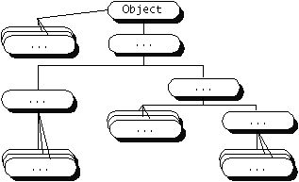
The Object Class
Every class in Java is an extended class, whether it is declared with an extends keyword or not.
If a class does not explicitly extend from another class, it implicitly extends the Object class.
public class myClass {…}
public class myClass extends Object {…}

Slide 51
The Object Class …
Object class provides methods for all objects:
  toString() clone() equals() …
Their code may not be very useful…
  So we often override them
but their existence is very useful
  ex: That’s why println can call toString for any object – all objects are guaranteed to have a toString method via inheritance

Slide 52
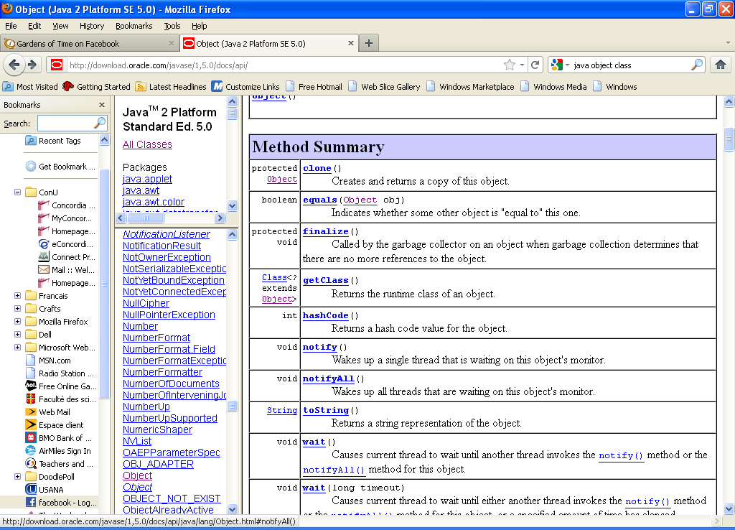
The equals method
the equals method is inherited from Object
equals in Object :

Slide 53
The equals method
So methods like this just overloads it:
  public boolean equals(Employee otherEmployee)
  { ... }
To override equals you must have:
  type cast the parameter to the given class (e.g., Employee)
  compare each of the instance variables of both objects

Slide 54
Example
public boolean equals(Object otherObject)
{
if(otherObject == null)
return false;
else if(getClass() != otherObject.getClass())
return false;
else
{
Employee otherEmployee = (Employee)otherObject;
return (name.equals(otherEmployee.name) &&
hireDate.equals(otherEmployee.hireDate));
}
}

Slide 55
instanceof and getClass
to check the class of an object
  instanceof operator
  getClass() method
    in Object class
    final method (cannot be overriden)

Slide 56
instanceof and getClass
getClass() method is more exact
  The instanceof operator simply tests if an object is an instance of (a descendent) of a class
    ex: fifi instanceof Dog,
    fifi instanceof Animal , …
  The getClass() method used in a test with
  == or !=
  tests if two objects were created with the same class
    ex: fifi.getClass() is Dog

Slide 57
The final modifier
with variables
  public static final int SIZE = 4;
  indicates a constant
with classes
  public final class xyz
  class cannot be extended
  be careful: you are violating fundamental OOP principle
  not used that much

Slide 58
The final modifier …
with methods
  public final int abc()
  method cannot be overridden
  ex: may not want to allow a complex or sensitive method to be changed

Slide 59
Example: Stop.java
public class Stop {
// final used with primitive values to create constants
// Attributes
public static final int STUFF = 20;
// proper way - value in the class
public final int fuzz = 5;
// also constant but a copy in every object
public final int val;
// blank final - value will be set later
// Methods
// initialize the blank final at run-time
// - cannot be changed after
public Stop(int val) { this.val = val; }

Slide 60
Example: Stop.java
// Methods
// cannot over-ride this method in any sub-class
public final int calculateFoo()
{ return fuzz + STUFF + val; }
public static void main (String[] args) {
Stop test = new Stop(100);
System.out.println("val = " + test.calculateFoo() );
}
}
STUFF = 20 (Static/final)
fuzz = 5 (Final)
val= ? (Final)
Output

